Slide 1
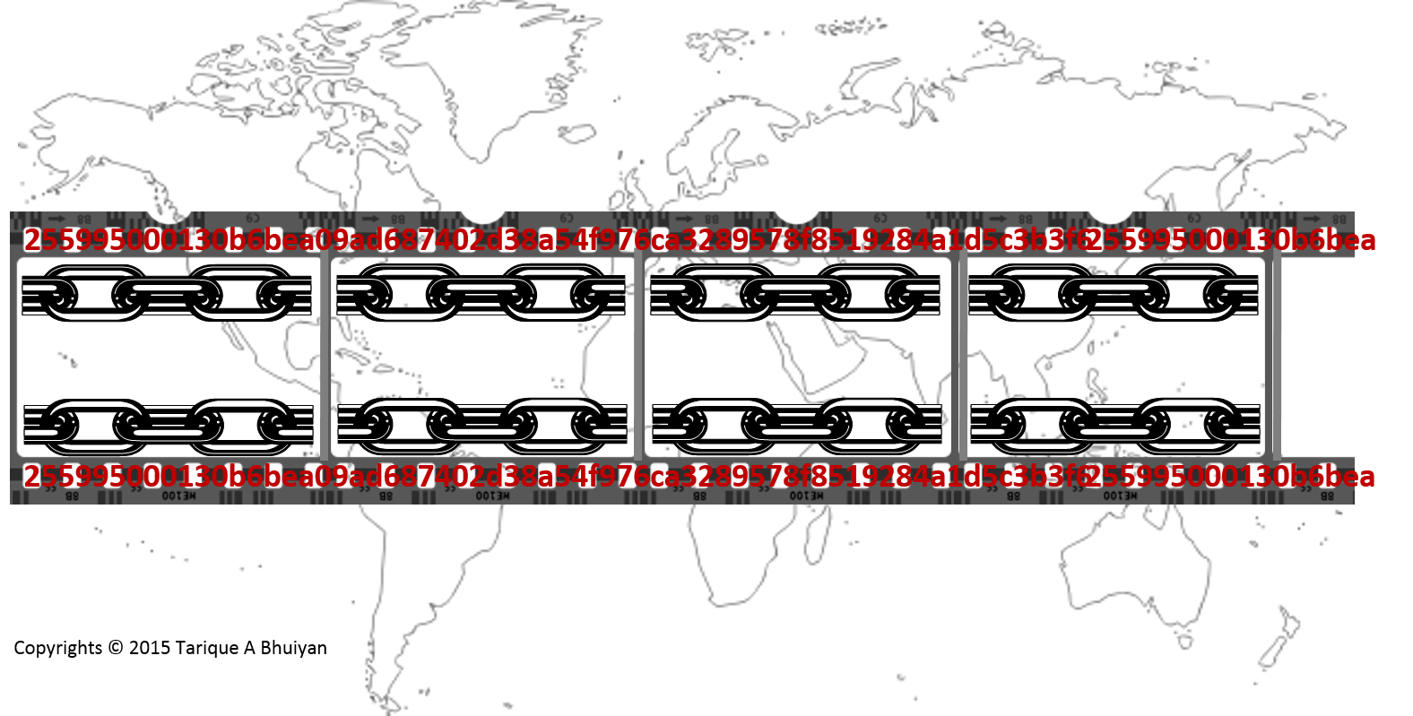
Presented @ Blockchain Seminar @ Deakin University
Presented By
Tarique A Bhuiyan
Founder, CEO & CTO
Hashkloud Pty Ltd
Dec 05, 2017

Slide 2
A brief history of bitcoin
Origins
Bitcoin vs Other Crypto-currencies

Slide 3



A brief History of Bitcoin (& Blockchain)
2017 (July): Bitcoin Split
2017 (December): >USD 10K
As of May 31, 2016: Bitcoin = USD 529.51
Bitcoin
Mining concepts
Max 21M Bitcoins
Value not yet stable?
Currency or Asset?
Blockchain
Distributed shared Ledger
SHA256, PKI based cryptography
Consensus model driven
2015: Ripple, Etherium, R3 Corda, HyperLedger, etc.
2013: Coloured Coins Proposed
2011: Bitcoin = ~USD 1.00
Satoshi Nakamoto
2009: Bitcoin Blockchain created
2009

Slide 4
Cryptography 101: SHA256
TaB → a474256dec2c9de04ef312c43ad819197c817e1ce233f1f2f0bc5b834caeca21
TAB → 125fd55e6b39a03456794c7eaf2ebd0f915afdb9aa3d4e15528bb19998b78059

Slide 5


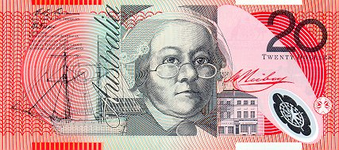
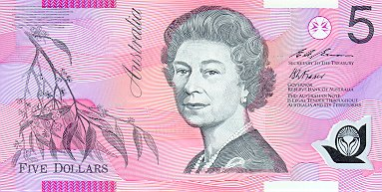

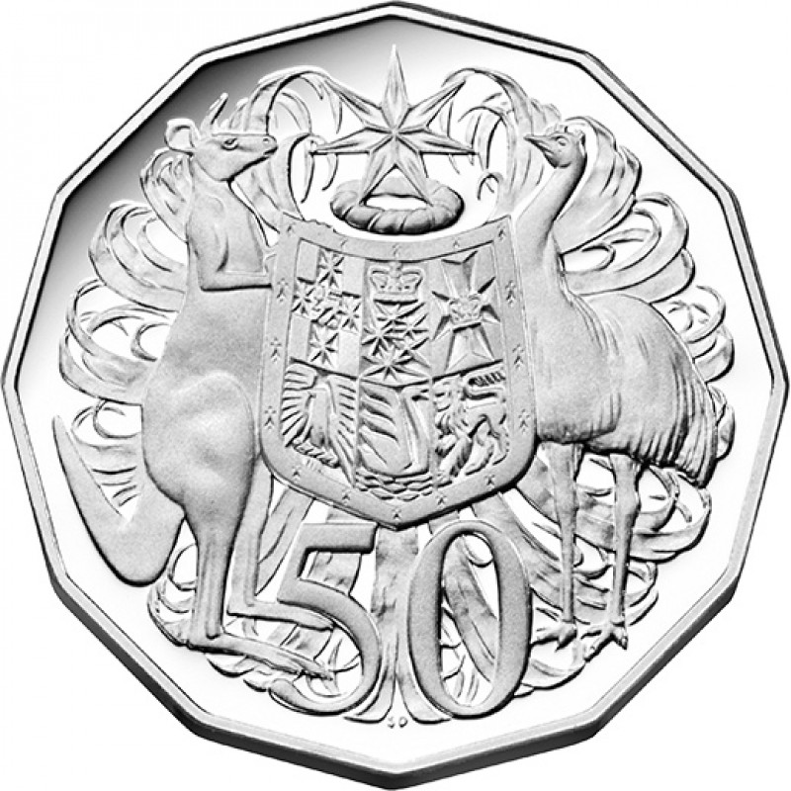
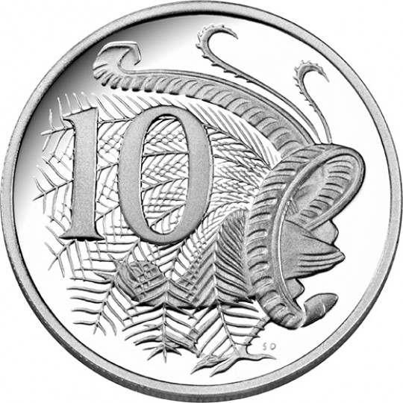
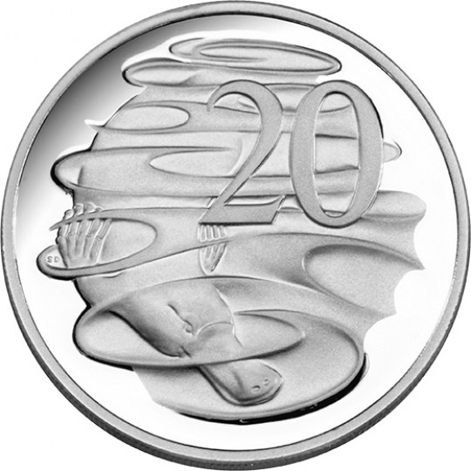
Bitcoin & cash analogy
Cash & Coin in your Wallet:
You go to a Coffee shop and buy a coffee for AUD 4.40
Out
In

Slide 6
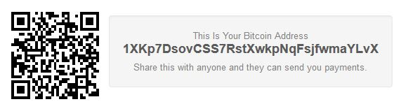
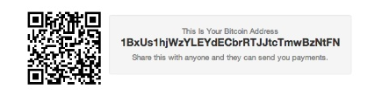

How bitcoin works?
Bitcoin in your Wallet:
You go to a Coffee shop and buy a coffee for BTC 0.00040o00
e14768dSOV5css9F……………………
e13768dSO65css9G……………………
BTC 0.00040000
e14e68dSOV5css5Q……………..……
+
BTC o.03300000
e238dgF65ysw7Z……………………
e14743dXOn5css3H……………………
e17943dkOn7xss6R……………………
BTC o.03260000

Slide 7
Blockchain 101
What is the Blockchain?
  Distributed Ledger
  Ledger Book analogy
  How Blockchain works
  Nonce & Proof of Work

Slide 8




What is a blockchain? three key Concepts of a Distributed ledger
DISTRIBUTED & CONSENSUS DRIVEN
SMART CONTRACT & AUTOMATED EXECUTION
Replicated across a number of systems
Almost real-time
Peer-to-Peer network
Consensus driven
Longest chain rule
Proof-of-work
Pre-written logic
Stored and replicated on a blockchain
Auto-executed
Can update the ledger
CRYPTOGRAPHICALLY SECURED & TRUSTED
Uses Cryptography (SHA256)
Uses Digital Signatures (PKI)
Blockchains are immutable

Slide 9
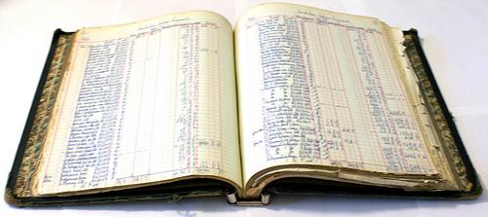

Blockchain Distributed Ledger & ledger book analogy

Slide 10
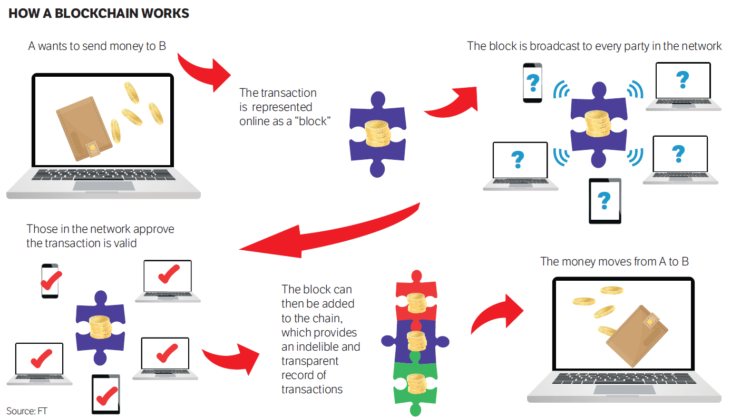
How blockchain works
Source: FT

Slide 11
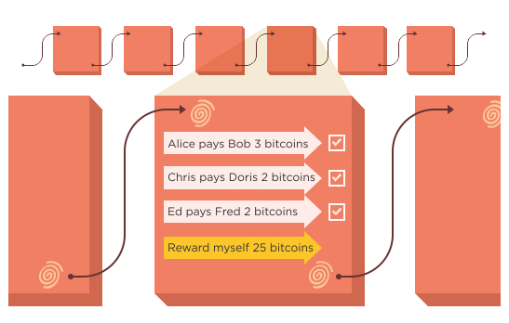
Blockchain Distributed Ledger & ledger book analogy

Slide 12
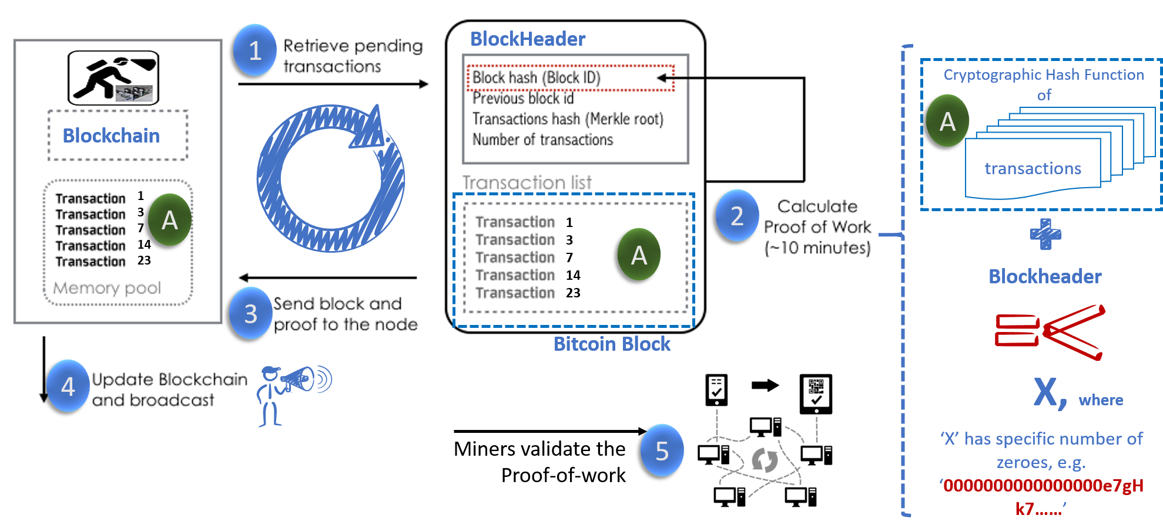
How BlockChain works?
?
Genesis Block mined by Satoshi Nakamoto in 2009
Candidate Blocks

Slide 13
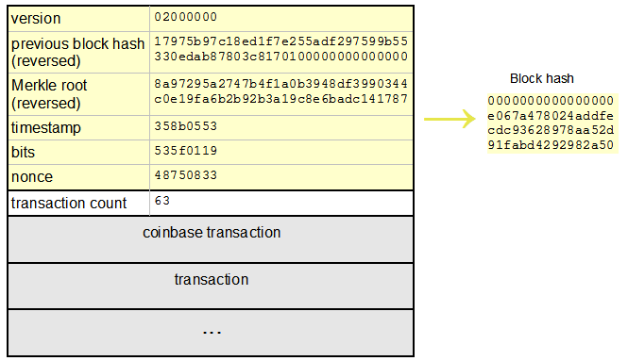
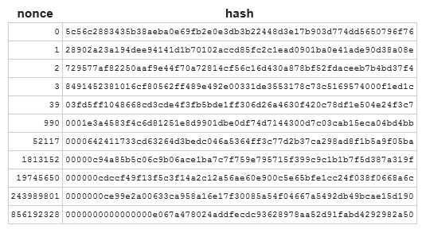
Nonce & Proof of work
Block Height = 286819
856192328
Source: http://www.righto.com/2014/02/bitcoin-mining-hard-way-algorithms.html

Slide 14
blockchain & banking

Slide 15
Blockchain & banking – advantages & Benefits
Advantages:
Cost Savings & Efficiency
Competing with Startups
New Business Models
Benefits:
Single source of information
The quality and speed of data is extremely high, consistent, precise
Blockchain can reduce human intervention
Blockchain are secure, scalable and durable
Disintermediation takes off both the risk and expense of counterparties
Possibility of failure or intrusion is almost negligible
Lower transaction costs can be tapped successfully
Faster processing for swift banking experience
Source: http://www.ciol.com/

Slide 16
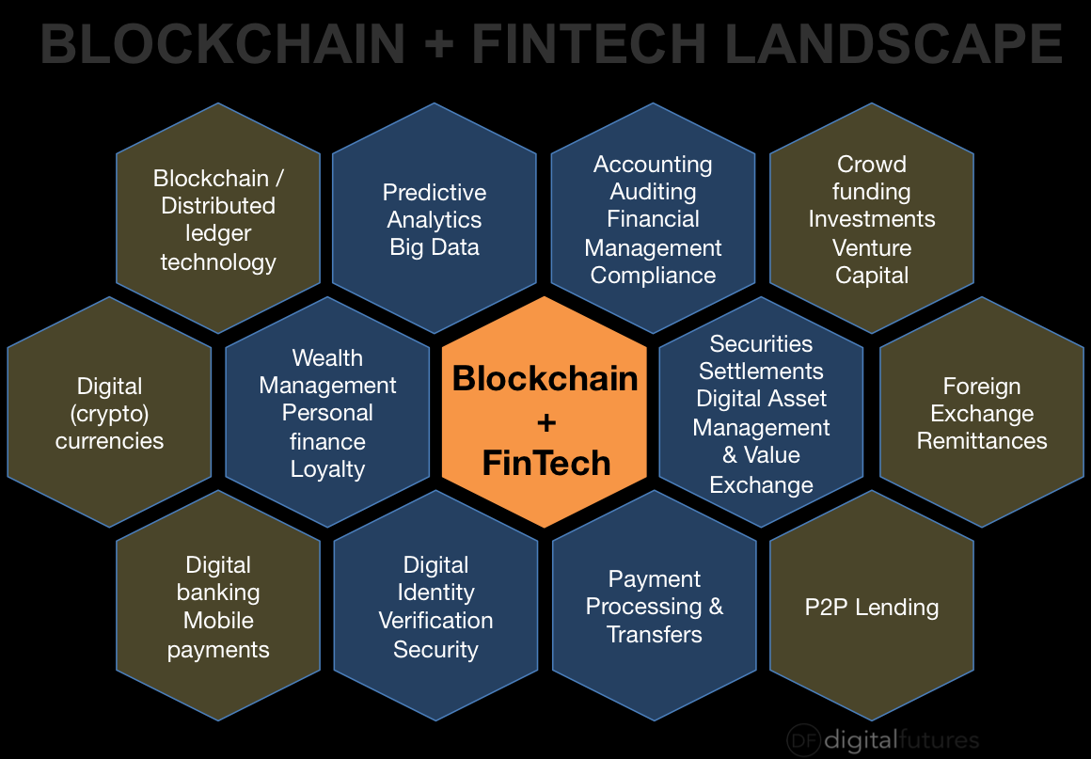
blockchain Use cases in banking
Use Case Areas:
Clearing & Settlements
Payments
Trade Finance
Identity
Syndicated Loans
Loyalty & Rewards
P2P Anything of Value
Source: https://www.ft.com/...
Source: DigitalFutures

Slide 17
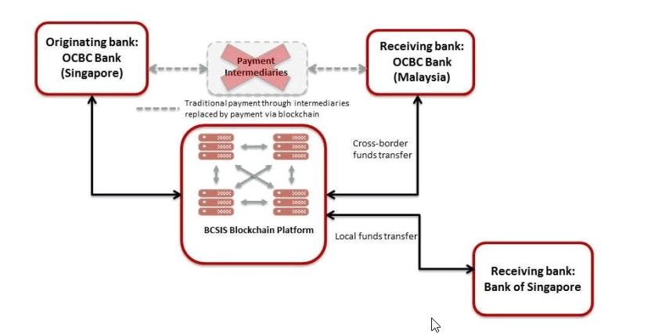
Payments (remittance) via blockchain
Source: http://fintechnews.sg/

Slide 18
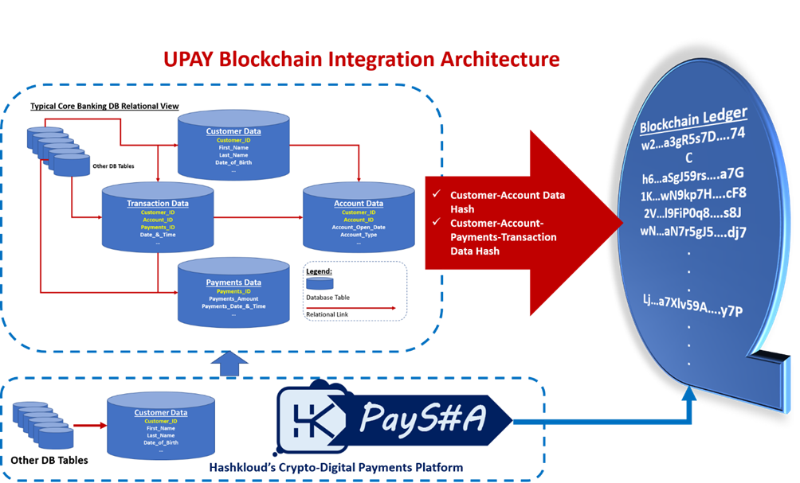
Hashkloud’s paySHA payments integration architecture
Bitcoin’s Blockchain

Slide 19
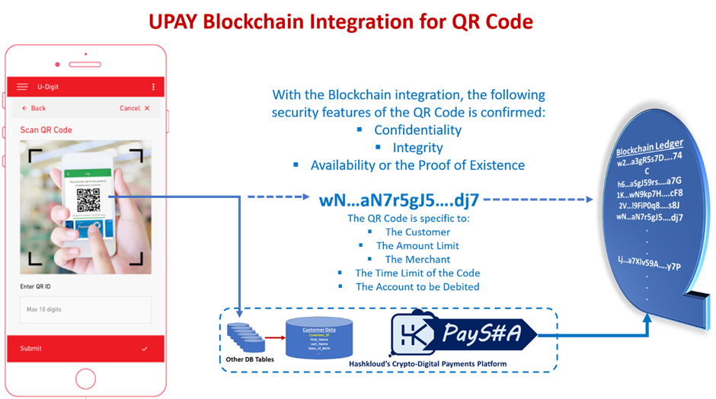
Hashklou’d payments qr code
Bitcoin’s Blockchain

Slide 20
Fintech Blockchain capability maturity model framework

Slide 21
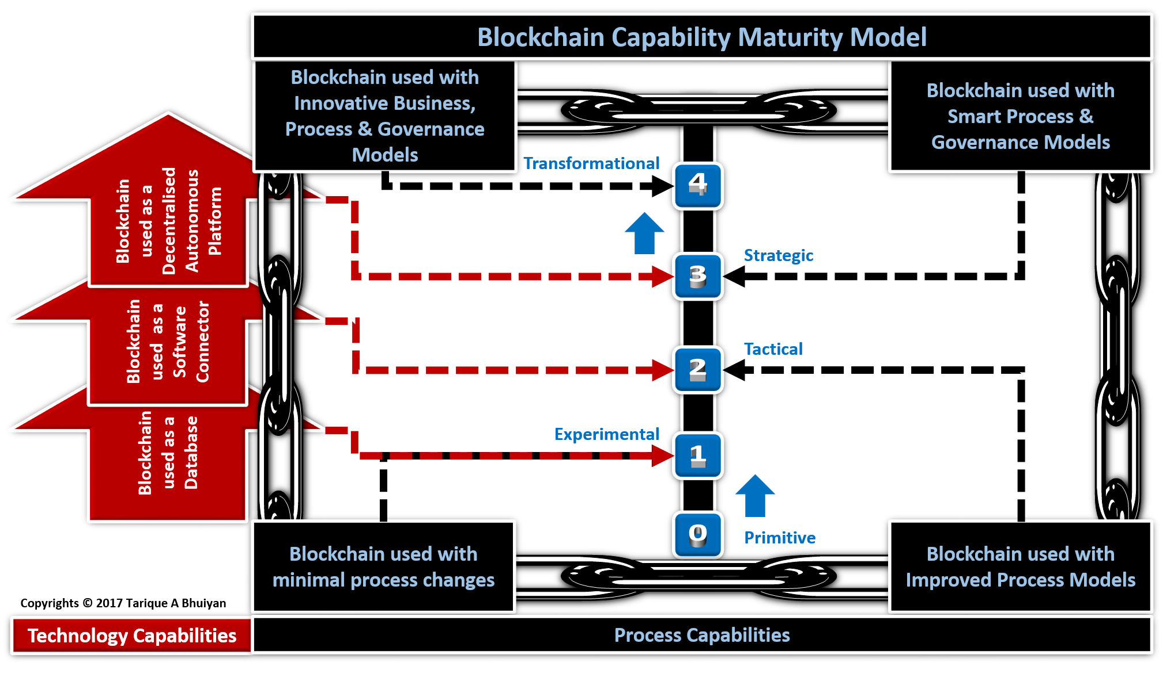
FINTECH blockchain capability model

Slide 22
Blockchain cmm framework s-curve

Slide 23

Questions…

Slide 24
THANK YOU ALL

